Slide 1




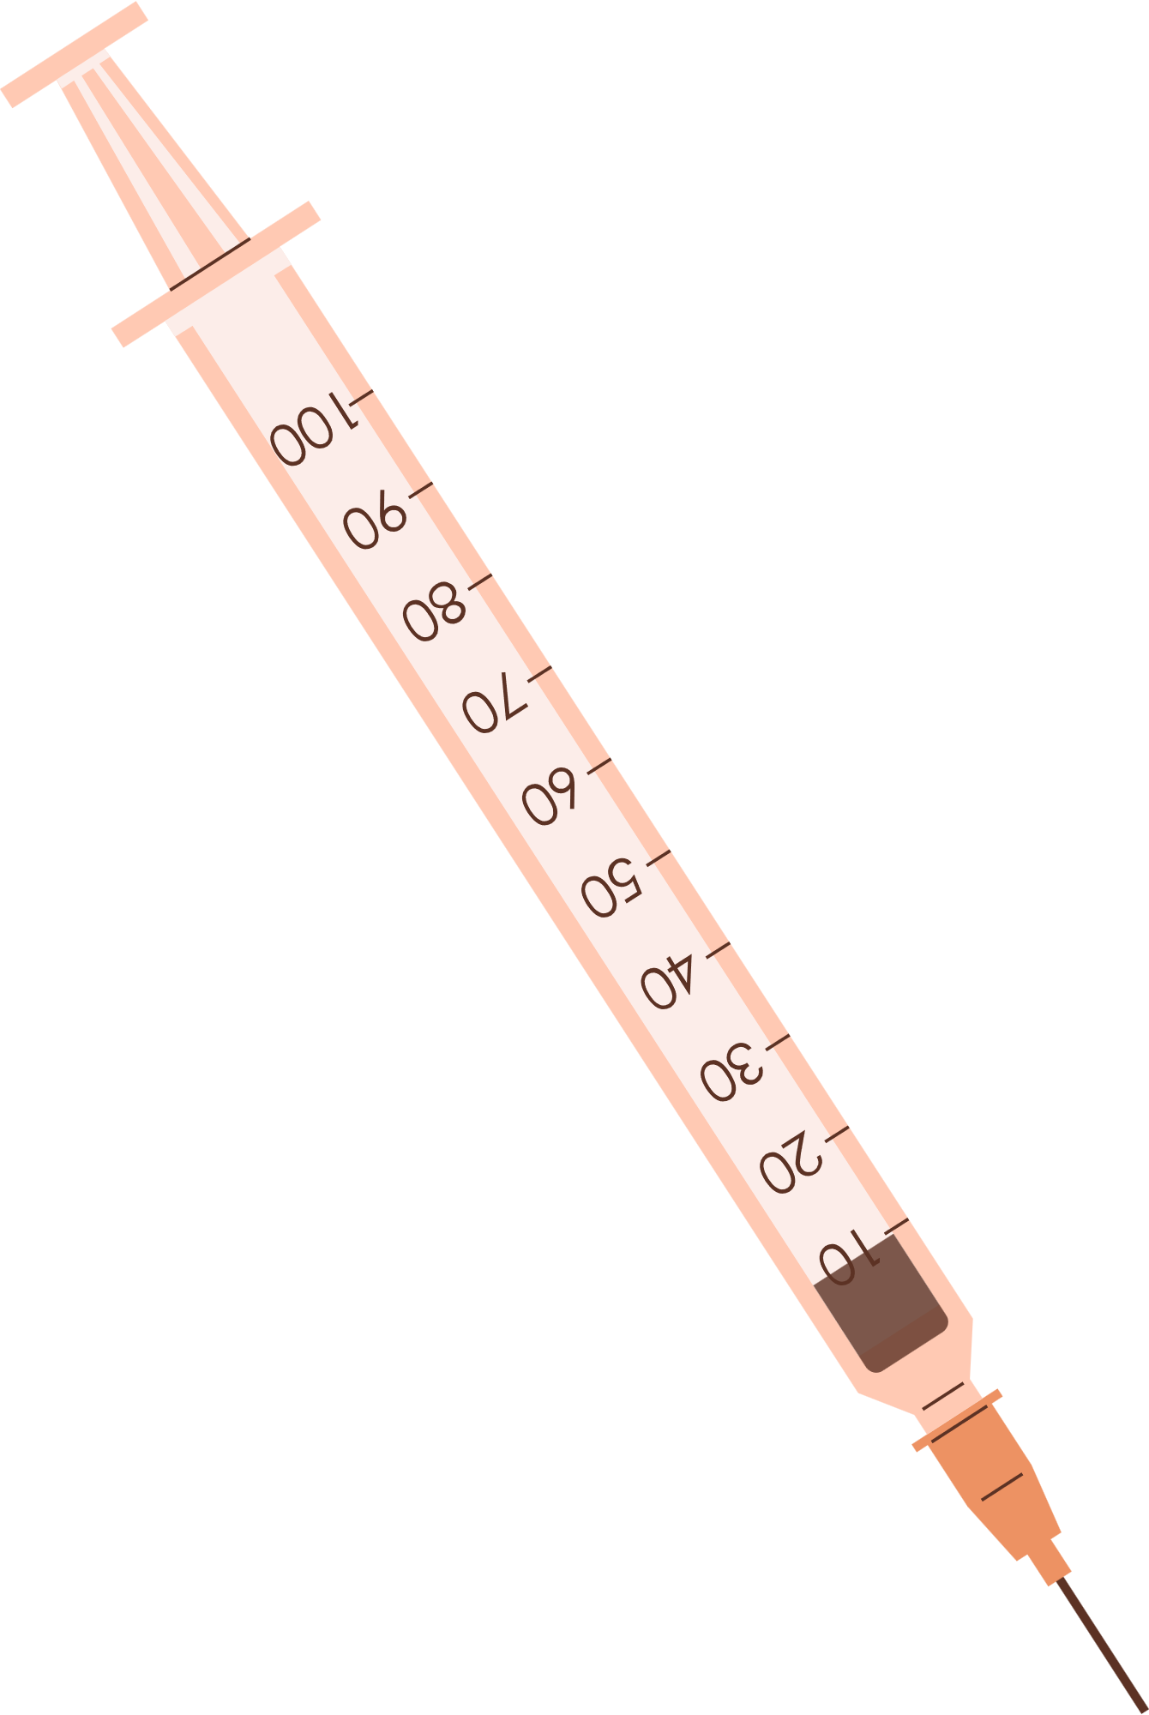



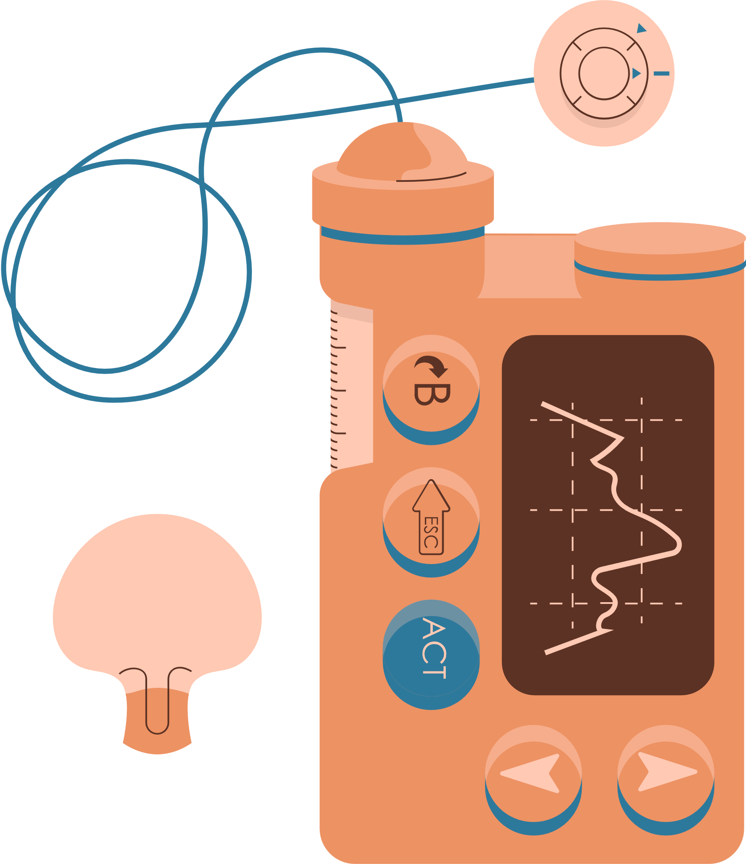


DIABETES PREDICTION – SQL
PSYLIQ Internship Project
Created by: Divya Pardeshi

Slide 2



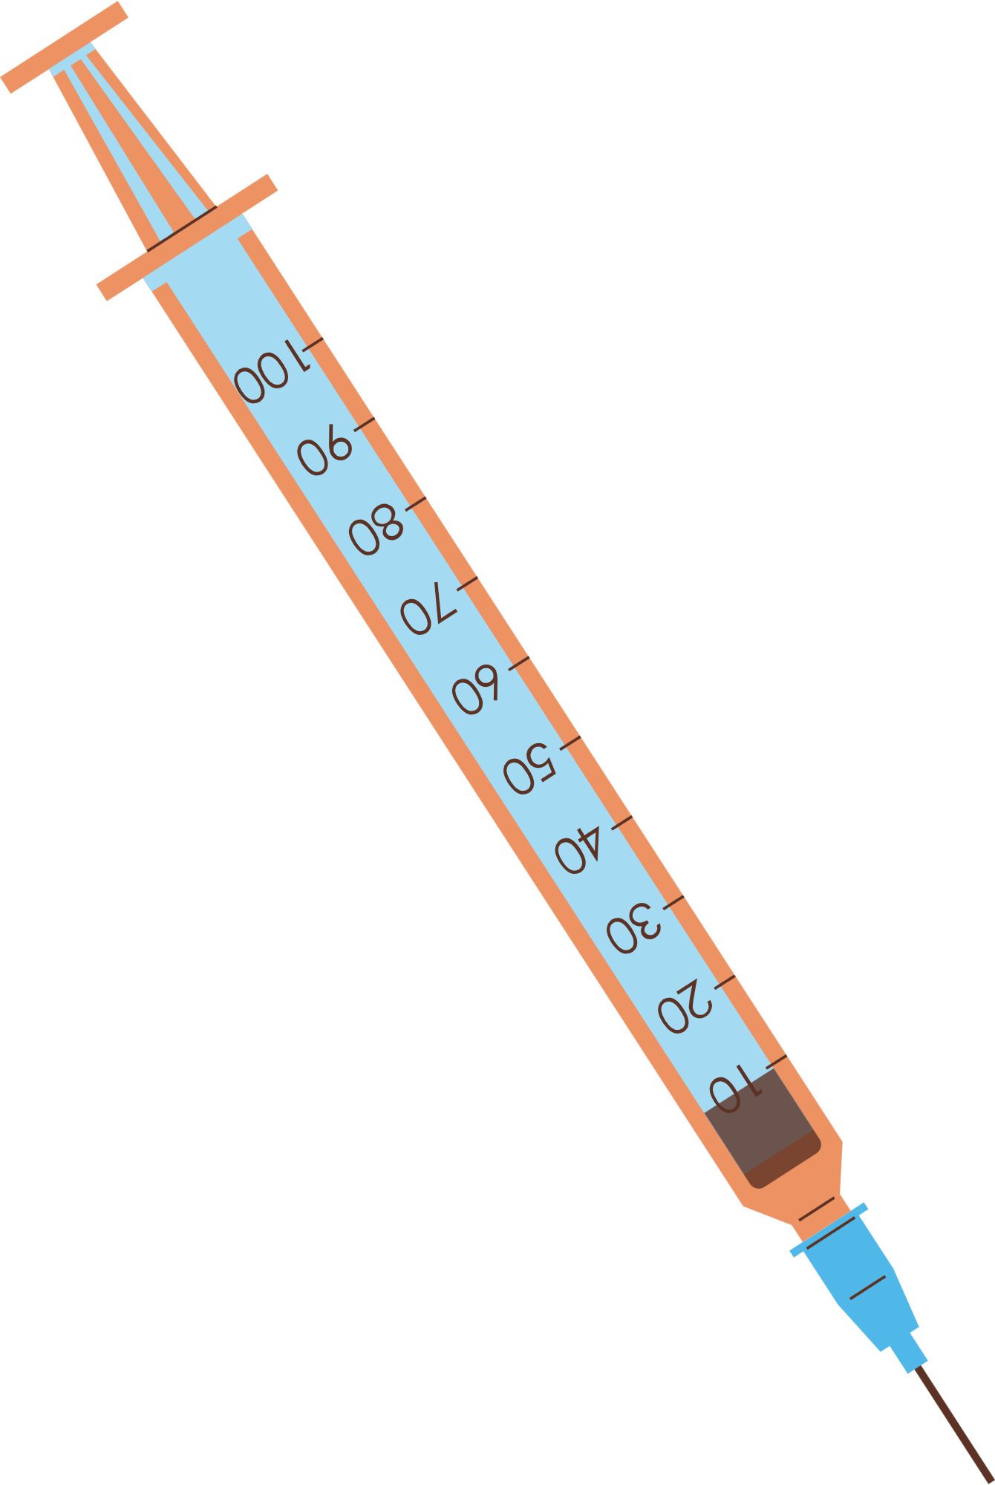



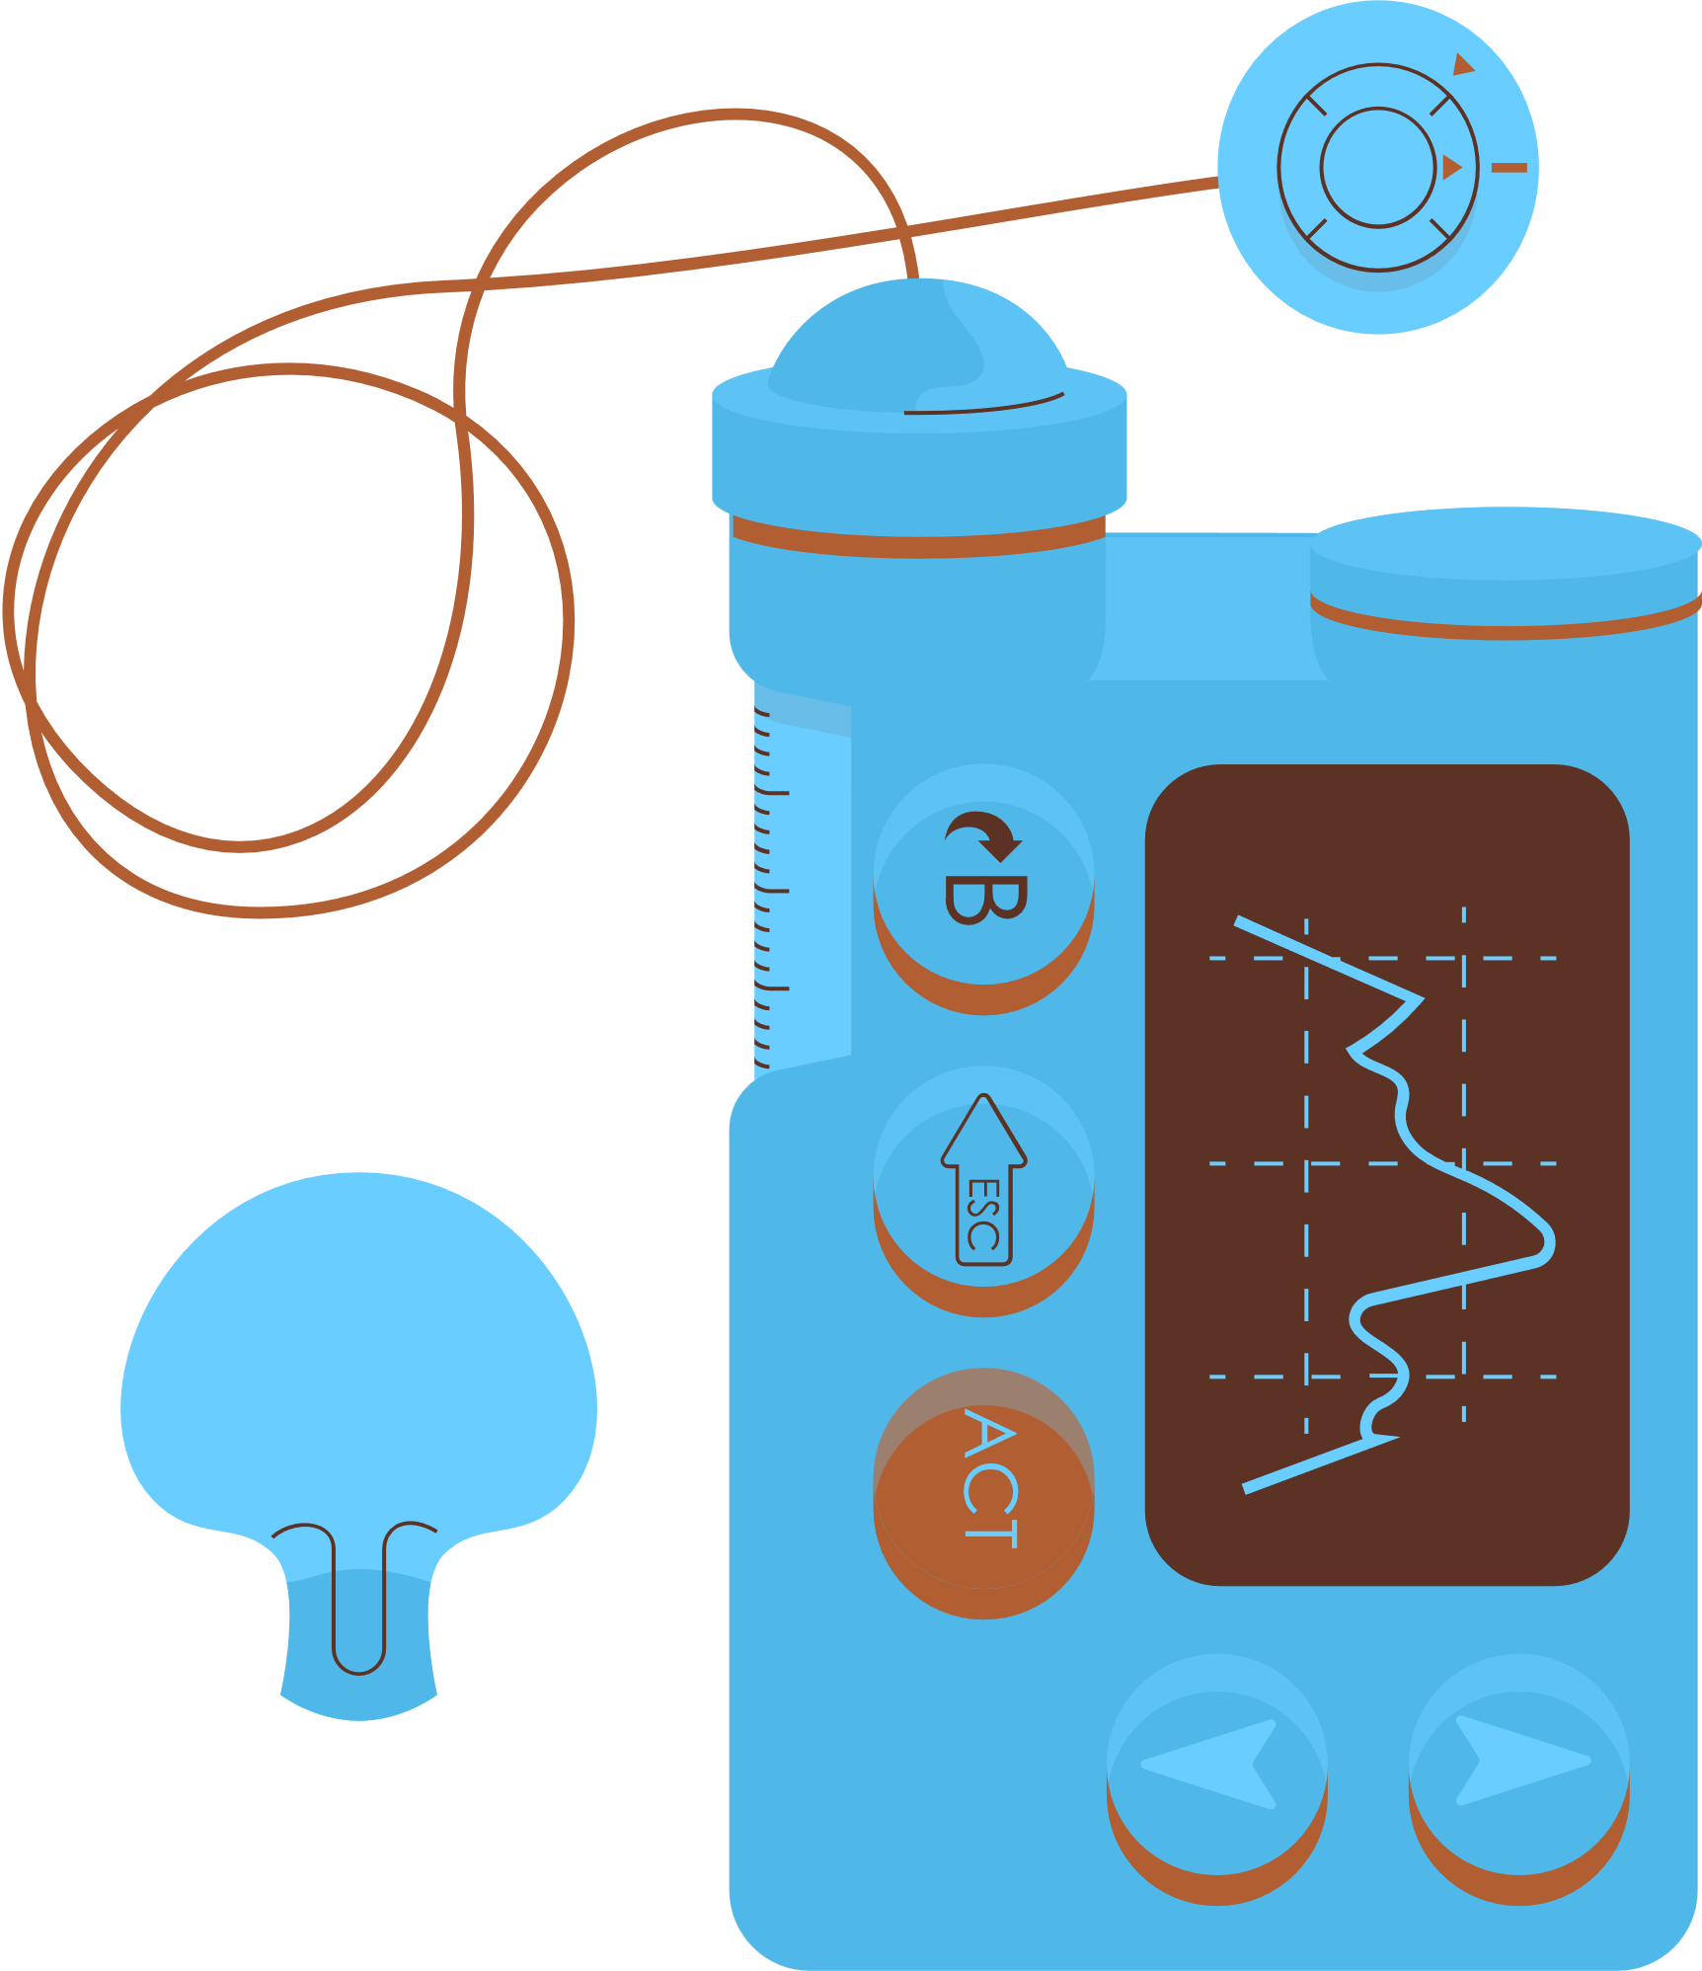


CONTENT
Introduction
Project Questions & SQL Queries
Summary

Slide 3

INTRODUCTION
In healthcare, integrating data-driven methodologies is crucial for deriving valuable insights and enhancing patient outcomes. This project undertakes a comprehensive analysis of the "Diabetes Prediction" dataset provided by PSYLIQ, which includes medical records for over 100,000+ patients. The dataset covers key attributes such as hypertension, heart disease, smoking history, BMI (Body Mass Index), diabetes, and other essential factors. By harnessing the power of MySQL, this project aims to reveal significant patterns and trends that can drive better prevention, early detection, and management of diabetes.

Slide 4



Project Questions
And SQL Queries

Slide 5
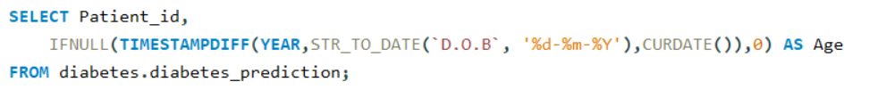

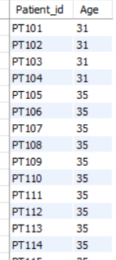

1. RETRIEVE THE PATIENT_ID AND AGES OF ALL PATIENTS.

Slide 6
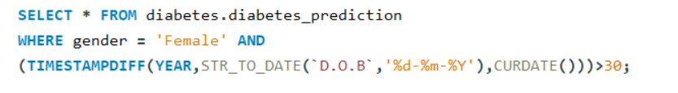
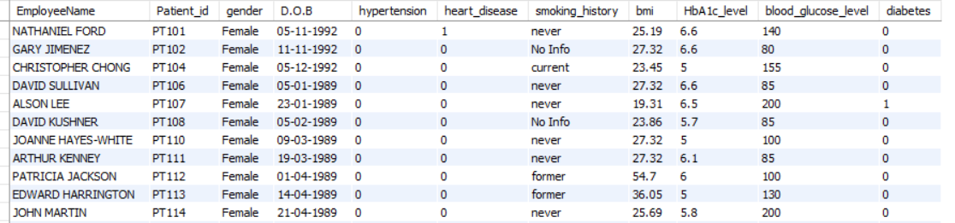

2. SELECT ALL FEMALE PATIENTS WHO ARE OLDER THAN 30.

Slide 7
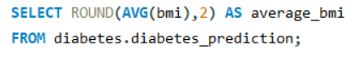

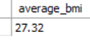
3. CALCULATE THE AVERAGE BMI OF PATIENTS.

Slide 8
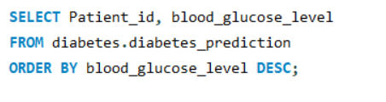
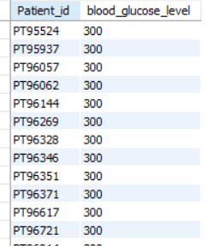

4. LIST PATIENTS IN DESCENDING ORDER OF BLOOD GLUCOSE LEVELS.

Slide 9
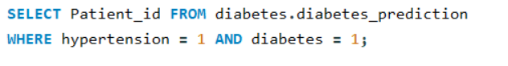
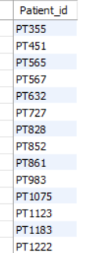

5. FIND PATIENTS WHO HAVE HYPERTENSION AND DIABETES.

Slide 10
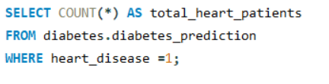

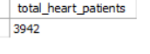
6. DETERMINE THE NUMBER OF PATIENTS WITH HEART DISEASE.

Slide 11
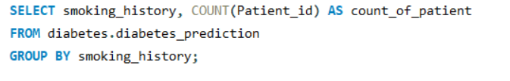
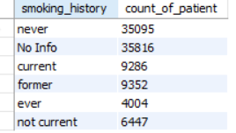

7. GROUP PATIENTS BY SMOKING HISTORY AND COUNT HOW MANY SMOKERS AND NON?SMOKERS THERE ARE.

Slide 12
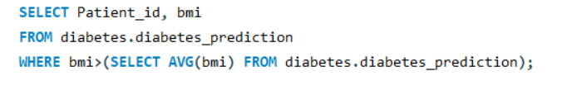
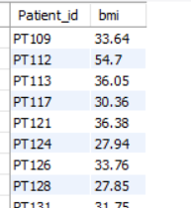
8. RETRIEVE THE PATIENT_ID OF PATIENTS WHO HAVE A BMI GREATER THAN THE AVERAGE BMI.

Slide 13
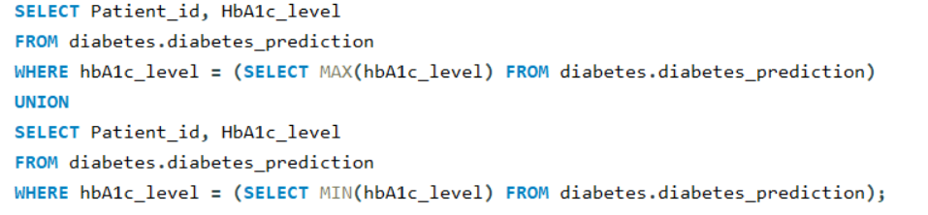
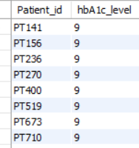
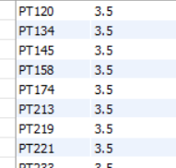
9. FIND THE PATIENT WITH THE HIGHEST HBA1C LEVEL AND THE PATIENT WITH THE LOWEST HBA1CLEVEL

Slide 14
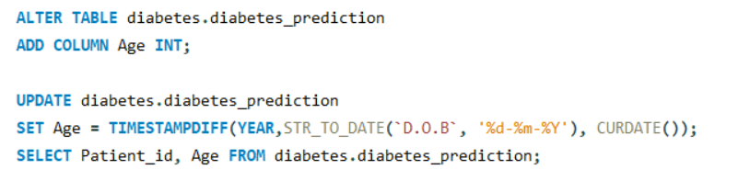
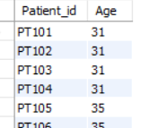

10. CALCULATE THE AGE OF PATIENTS IN YEARS (ASSUMING THE CURRENT DATE AS OF NOW).

Slide 15
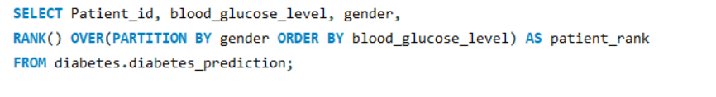
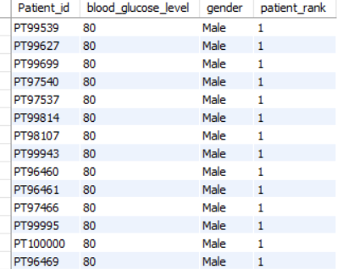
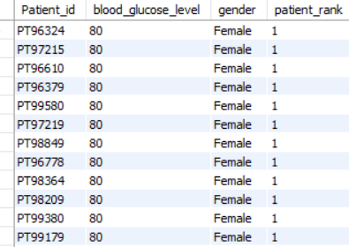

11. RANK PATIENTS BY BLOOD GLUCOSE LEVEL WITHIN EACH GENDER GROUP.

Slide 16


12. UPDATE THE SMOKING HISTORY OF PATIENTS WHO ARE OLDERTHAN 40 TO "EX-SMOKER."
There are no patients in the dataset where the age is greater than 40, hence the output is a blank table.

Slide 17
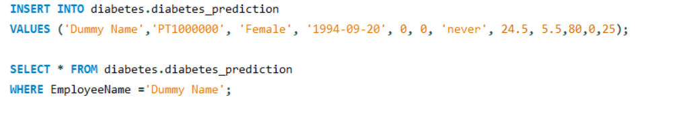


13. INSERT A NEW PATIENT INTO THE DATABASE WITH SAMPLE DATA.

Slide 18
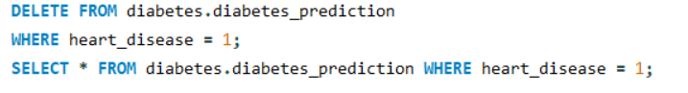
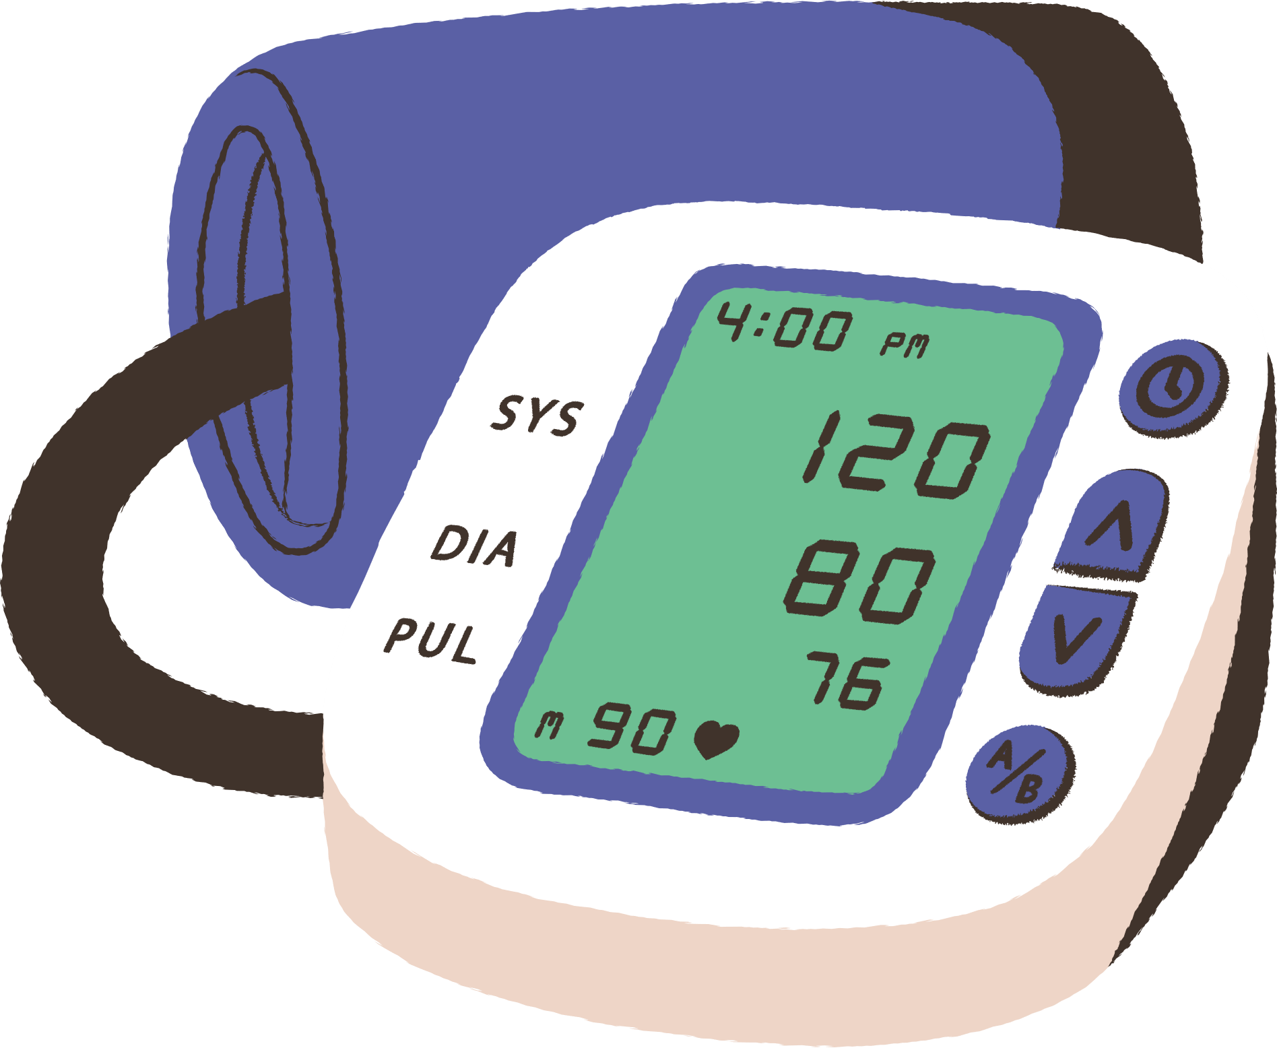
14. DELETE ALL PATIENTS WITH HEART DISEASE FROM THE DATABASE.

Slide 19
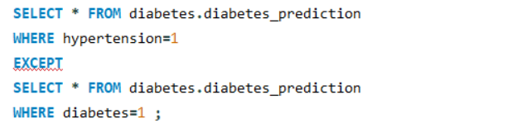
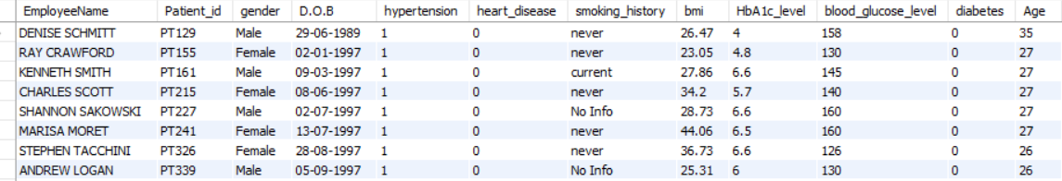

15. FIND PATIENTS WHO HAVE HYPERTENSION BUT NOT DIABETES USING THE EXCEPT OPERATOR.

Slide 20
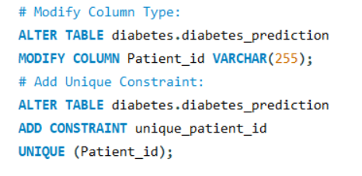

16. DEFINE A UNIQUE CONSTRAINT ON THE "PATIENT_ID" COLUMN TO ENSURE ITS VALUES ARE UNIQUE.

Slide 21
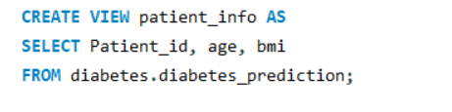
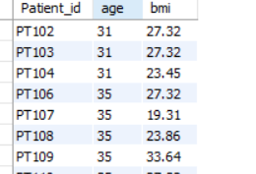
17. CREATE A VIEW THAT DISPLAYS THE PATIENT_IDS, AGES, AND BMI OF PATIENTS.

Slide 22
18. SUGGEST IMPROVEMENTS IN THE DATABASE SCHEMA TO REDUCE DATA REDUNDANCY AND IMPROVE DATA INTEGRITY
Normalize the Schema: Create a separate table to Store patient-specific details such as Patient id, Employee Name, gender, and Date of Birth. This helps to centralize patient information and avoid duplication and a separate table to store health-related attributes such as hypertension, heart disease, smoking history, bmi, HbA1c level, blood glucose level, and diabetes. This separates health information from general patient information, making it easier to manage and update.
2. Data Type Considerations: Consider creating a fixed-length character field (e.g., CHAR(1))
to store gender, which ensures consistency and reduces storage requirements. Use the
date data type field for the date of Birth column. Additionally, Use decimal types to store
precise numerical values with a fixed number of decimal places For columns
like (bmi,HbA1c_level).
3. Data Integrity: Ensure that each table has a unique identifier (e.g., Patient id as a primary
key) to enforce uniqueness and enable accurate referencing between tables and
Implement foreign key relationships to maintain data consistency and integrity
across related tables, linking health details to specific patients.

Slide 23
19. EXPLAIN HOW YOU CAN OPTIMIZE THE PERFORMANCE OF SQL QUERIES ON THIS DATASET.
Database Schema Design: Normalize tables to minimize redundancy and use appropriate data types to ensure efficient storage and querying.
Indexing: Create indexes on columns frequently used in WHERE clauses, JOIN conditions, or ORDER BY clauses to speed up data retrieval.
Optimize Queries: Select only the necessary columns (SELECT specific fields) and filter data as early as possible in the query to reduce the amount of data processed. Apply the LIMIT clause to restrict the number of rows returned, which can enhance query performance and manage large result sets.
Query Execution Plan: Use tools like EXPLAIN to analyze query execution plans and identify bottlenecks or inefficiencies in your queries.

Slide 24
THANK YOU!
Divya Pardeshi
- Data Analyst Intern at Psyliq

